Slide 1
Snake Game AI
Team 10 Reinforcement Learning 11/5/2024

Slide 2
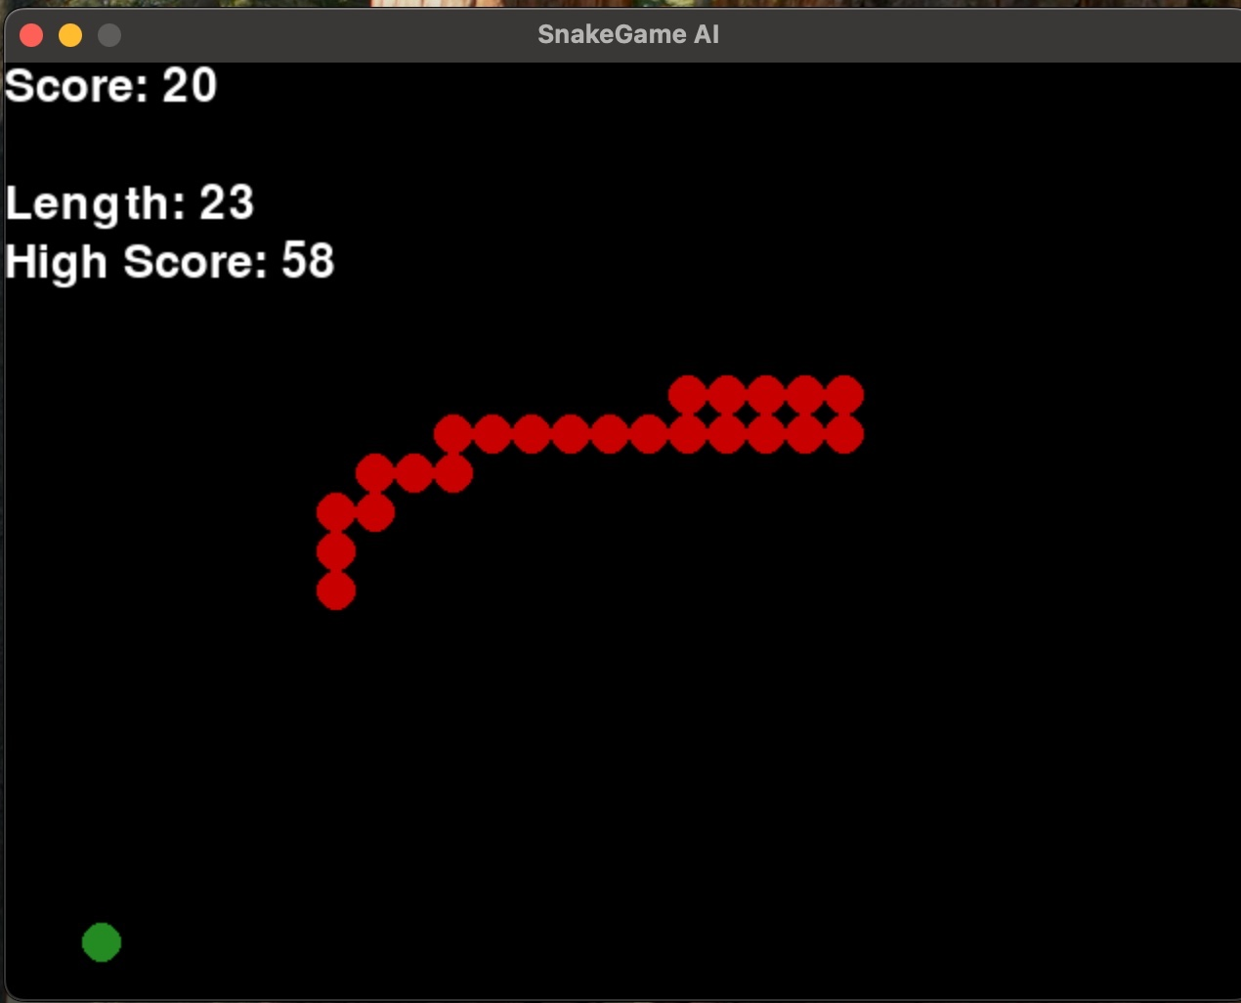
Project Description
The objective of this project is to develop an AI agent capable of playing the classic Snake game
The challenge is in maximizing the snake’s length as long as possible without running into its own body or game’s boundaries.
The agent must make best choices as possible at every stage since every action it takes has an impact on the events that follow.

Slide 3
Background
Snake Game AI: Previous works in Snake AI focused on basic Q-learning or rule-based strategies, limiting scalability. The scalability and dynamic techniques needed for extended games pose issues with these approaches.
Complex Reward Mechanisms: This project employs an extensive reward system that promotes longer and safer gameplay, in contrast to previous works that used simple scoring.
Why This Approach?: In order to provide a reliable and scalable AI solution for Snake, the project focuses on utilizing cutting-edge RL techniques to get over the drawbacks of past rule-based and traditional Q-learning approaches.

Slide 4
Environment
Description of the Game:
Objective: The goal is for the agent (snake) to consume food by navigating a grid and growing longer while avoiding collisions with itself and walls.
Grid Layout: The game is played on a rectangular grid, with food and the snake.
Game rules: The snake can travel in four different directions: up, down, left, and right. When it consumes food, the agent is rewarded, which causes snake to grow. The game ends if it collides with barriers or itself.
State Representation:
The current position of the snake (head and body segments) Position of the food.
Direction of movement:
The distance to the nearest obstacles such (boundaries, body segments)

Slide 5
Action Space: Move up, Move down, Move left, Move right
Reward System: Positive Rewards +1 , Negative Rewards -10
Environment Dynamics: The agent's position on the dynamic grid is always shifting in response to its actions. Predicting and adjusting to the outcomes of every step is part of the challenge, which gradually strengthens the learning process.

Slide 6
Methods
Overview of the Algorithms used in our model: Deep Q-Network: Estimates the future reward for each action using a neural network to approximate the Q-value function, which helps the agent in making the best choices. Double DQN: Uses Double Q-learning to minimize overestimation. By decomposing the maximum operation in the target into action selection and action evaluation.
Advantage Actor-Critic: Value-based and policy-based learning are combined in this on-policy algorithm. It balances exploration and exploitation by stabilizing policy changes using advantage values.
.

Slide 7
Dueling DQN: By distinguishing between state value and action advantage, it improves Q-value estimate and concentrates learning on crucial actions. Prioritized experience replay: By selecting events with greater significance based on their TD mistake, prioritized experience replay increases learning efficiency. Proximal Policy Optimization: balances exploration and exploitation in continuous spaces by clipping gradients to guarantee stable policy updates.
Algorithm | Performance in High Dimensional Spaces
DQN | Moderate
Double DQN | Moderate
A2C | high
Dueling DQN: | high
Prioritized Experience Replay | high
PPO (Proximal Policy Optimization) | Low

Slide 8
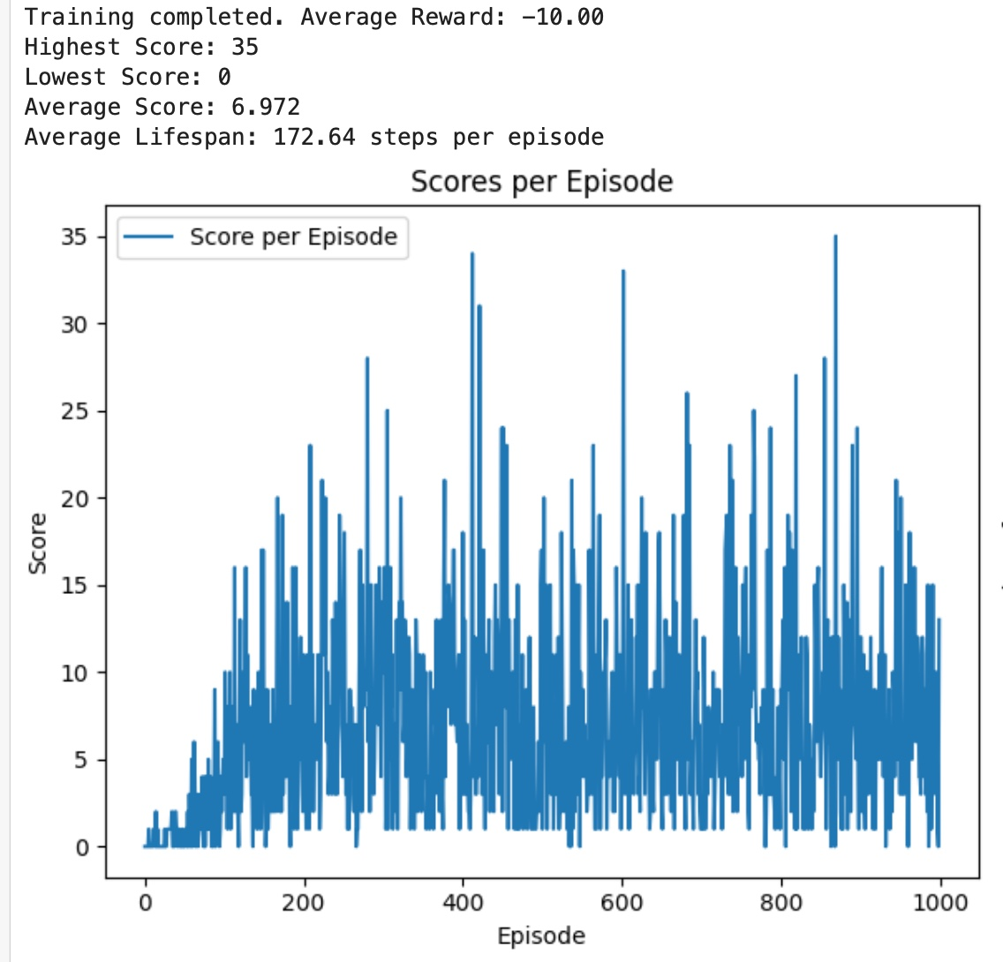
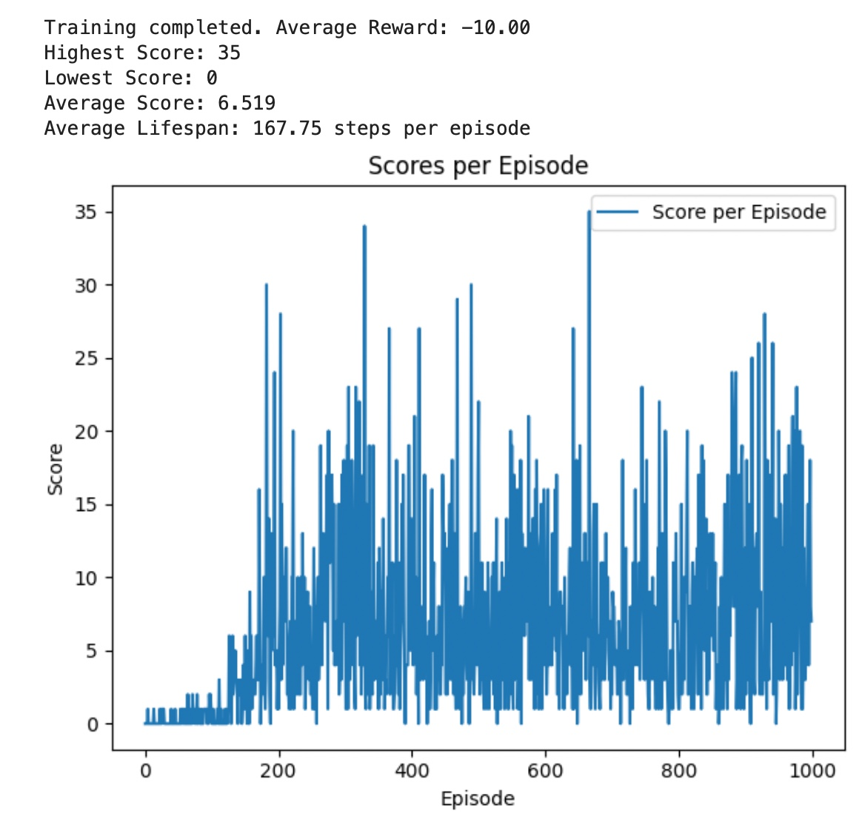
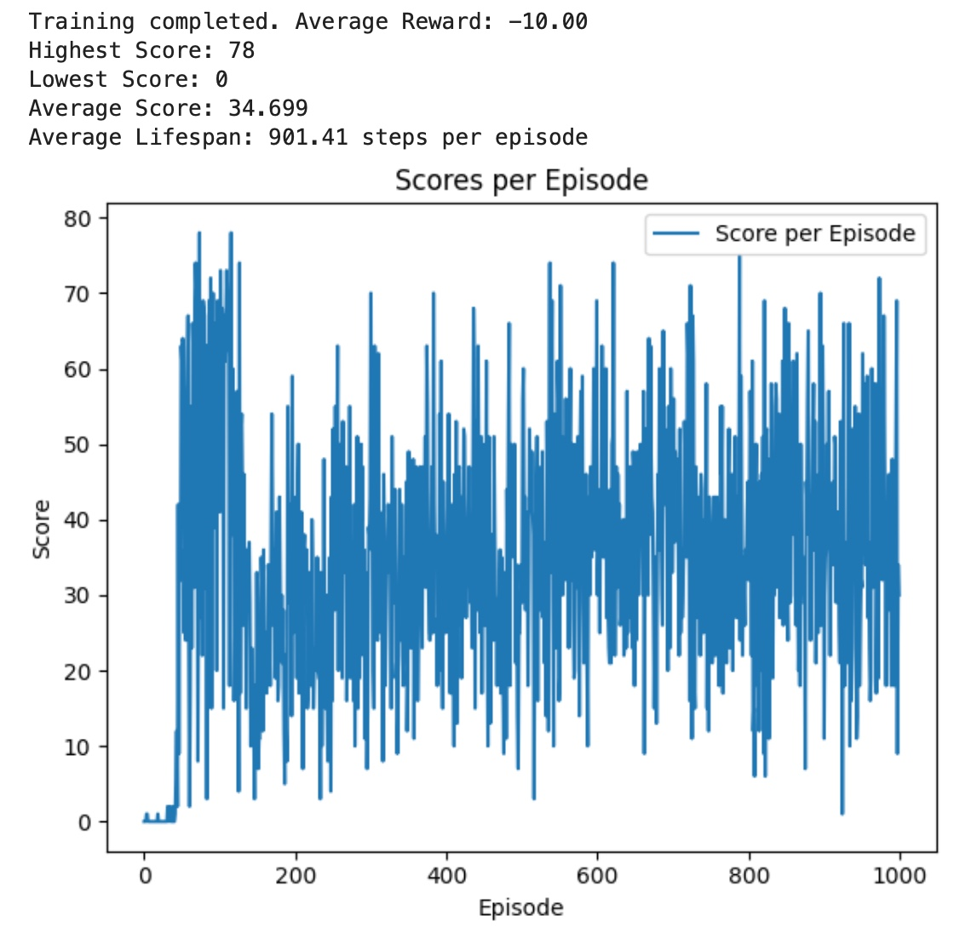
Results
Baseline Algorithms
DQN
Double DQN
A2C

Slide 9
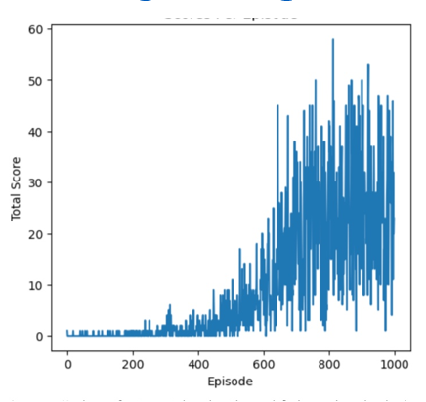
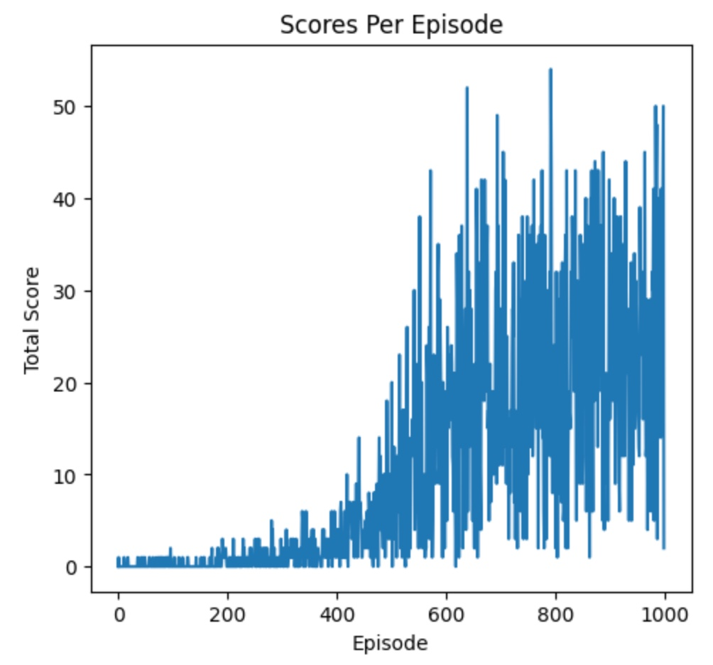
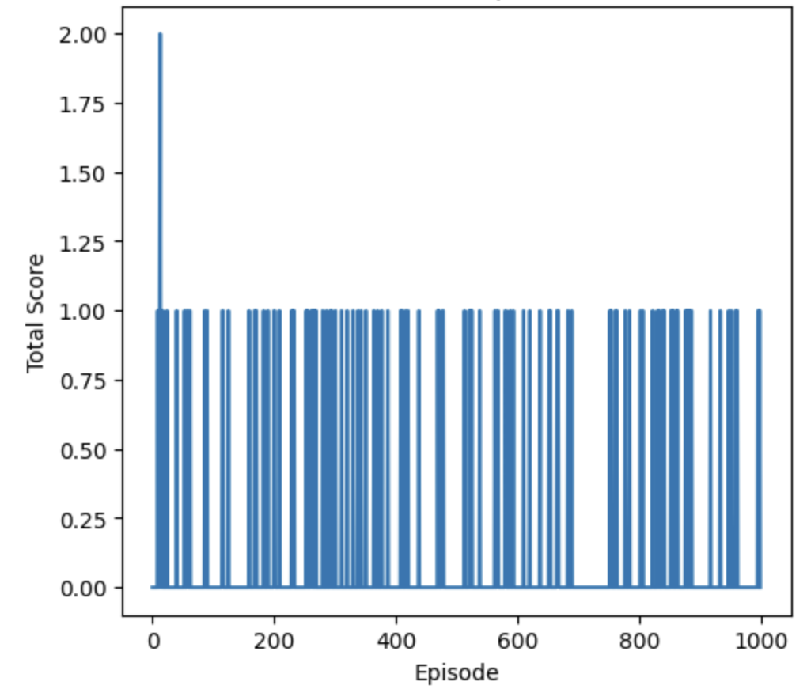
Improved Algorithms
Dueling dqn
pER
PPO

Slide 10
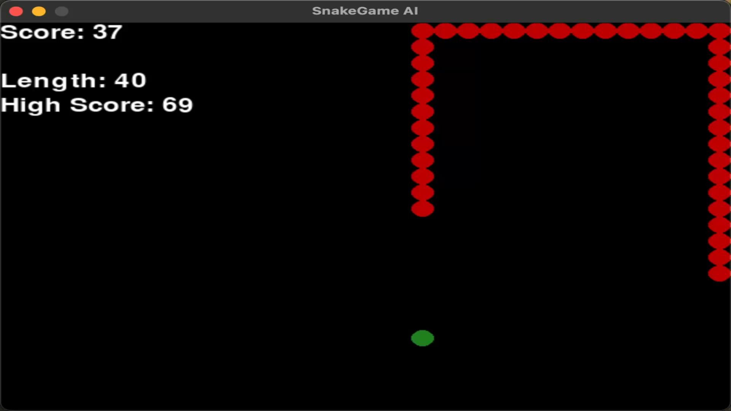
Training Demo

Slide 11
Summary
Baseline algorithms considered: DQN, Double DQN, A2C.
DQN & Double DQN: Moderate performance with improved stability in Double DQN.
A2C: Outperformed both DQN and Double DQN due to its actor-critic structure.
Advanced algorithms introduced: Dueling DQN, Prioritized Experience Replay (PER), PPO.
Dueling DQN & PER: Achieved high performance by enhancing Q-value estimation and focusing on critical transitions.
PPO: Lower performance due to inefficiencies in adapting its policy updates to discrete environments like Snake.
Future Work: Introduce multi-agent systems to model scenarios with competing or cooperative Snake agents. Investigate hierarchical reinforcement learning for more effective long-term planning.

Slide 12
References
DQN
https://medium.com/@shruti.dhumne/deep-q-network-dqn-90e1a8799871
DoubleDQN
https://medium.com/@qempsil0914/deep-q-learning-part2-double-deep-q-network-double-dqn-b8fc9212bbb2
A2C
https://medium.com/intro-to-artificial-intelligence/the-actor-critic-reinforcement-learning-algorithm-c8095a655c14
Snake game AI https://medium.com/@nancy.q.zhou/teaching-an-ai-to-play-the-snake-game-using-reinforcement-learning-6d2a6e8f3b1c
PER : https://towardsdatascience.com/how-to-implement-prioritized-experience-replay-for-a-deep-q-network-a710beecd77b
Dueling DQN :
https://towardsdatascience.com/dueling-deep-q-networks-81ffab672751

Slide 13
Contribution Summary
Team Member | Project Part | Contribution
bhavanik | Baseline and Improved Algorithms | 50%
smoganti | Baseline and Improved Algorithms | 50%

Slide 14
THANK YOU

